Slide 1
Angel 3.0
A Full Stack Machine Learning Platform
Fitz
Tencent
Notes:
Hello everyone, I am Fitz Wang, comes from Tencent. Many thanks for Linux foundation AI to provide the opportunity to release Angel 3.0.
Today’s topic is “Angel 3.0: a full stack machine learning platform”

Slide 2
Agenda
Overview
What is Angel ?
Angel 2.x: User & market & open source
New Features Of Angel 3.0
Auto Feature engineering
Computation engines:
Spark On Angel: Adapt to Spark 2.4, DataFrame API, Pipeline
PyTorch On Angel: introduce PyTorch as a computation engine
Hyper parameter tuning
Model serving
Others: Kubernetes Support, Faster GBDT
User Cases
Notes:
This is today’s agenda:
First, we will make a brief review about Angel.
Then, recall what we achieved since the release of Angel 2.0 in three aspect:
1) users
2) market place
3) open source statistics
Next we will introduce the new features of Angel 3.0, including:
1) auto feature engineering
2) tow computation engines
3) hyper parameter tuning
4) model serving
At last, we shared two user cases

Slide 3
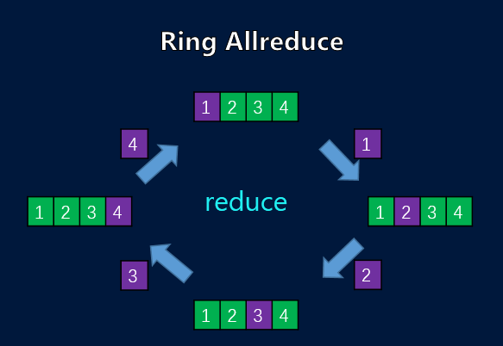
What is Angel ?
Angel is a large scale distributed machine learning platform:
Foundation: Efficient and High available Parameter server
Differentiation: Sparse data & huge models
Field/Domain: Recommendation, Graph Learning (GE / GNN)
Notes:
What is Angel?
Angel is a large scale distributed machine learning platform for sparse data and huge model. There are many machine learning platform in the industry, such as TensorFlow, PyTorch, MxNet, PadlePadle and Spark. What makes Angel special ? I think the underlying reasons are
Angel is build on an efficient and High available Parameter server(PS). The distinguished feature of Angel PS is that Angel support parameter server function (PSF), which allow to push calculation down to the PS. Compared with other synchronize approach, such as all reduce, Angel PS do not require all the parameters store on a single node. Both the horizontal scalability of PS and the flexibility of PSF make Angel PS suitable for training huge models with trillion of parameters.
There is a self-developed math lib in Angel. The math lib is designed for high dimensional sparse data calculation. Our math lib the 10X faster than breeze in sparse calculation.
For the above-mentioned reasons, the algorithms of Angel focus on recommendation and graph learning. The radar figure show that Angel is very different with other platforms, such as TensorFlow, PyTorch and spark. Both TensorFlow and PyTorch are excellent at deep learning but they are not good enough at dealing with huge models and sparse data. While Angel is good at.

Slide 4
Angel Architecture
Angel Math Library: Self-developed mathematics library optimized for sparse vectors
Angel PS: manage model parameters
ML Engine: PyTorch, Angel mlcore (Angel Computation graph, Angel Tree Core)
Distributed executor: Angel, Spark On Angel , PyTorch On Angel
Public service components: AutoML, Serving
AutoML (AFE/HPT)
Serving
Angel Native
Spark
on Angel
PyTorch
On Angel
Angel PS
Angel mlcore
PyTorch
Matrix
Graph
Angel Math Library
existing
enhanced
new
outter
Notes:
This slice show the component architecture:
The self-developed math lib lies at the bottom, it is optimized for sparse vectors
Angel parameter server is based on the math lib and provide efficient and high available parameter service
Except for PS, there are two computation engines: PyTorch, Angel mlcore (Angel Computation graph, Angel Tree Core)
Distributed executors are build on the computation engines. There are three executors: Angel, Spark On Angel , PyTorch On Angel
Public service components are on the top, including AutoML, angel Serving

Slide 5






Angel inside Tencent
Task and User statistics
Task stats
Index | Value
Total Task Num | 2400+
Running Task Num in a Month | 9000+
Task Num per Day | 300+
Total Users | 280+
Active Users In Month | 150+
Active Users In Day | 80+
Notes:
Angel inside Tencent
The left figure show the number of tasks running on Angel since last June. As you see, the task number increase 2 and a Half times. Especially, the tasks on SONA increase almost 10 times. Due to this reason, we upgrade SONA in Angel 3.0 to make it more user friendly. The left table show some detailed statistics. Such as active users in month and day. Form the number, we can conclude that Angel project running very well in Tencent.
Moreover, some of the popular apps, such as Tencent video, Tencent news and WeChat, are all Angel’s users.

Slide 6


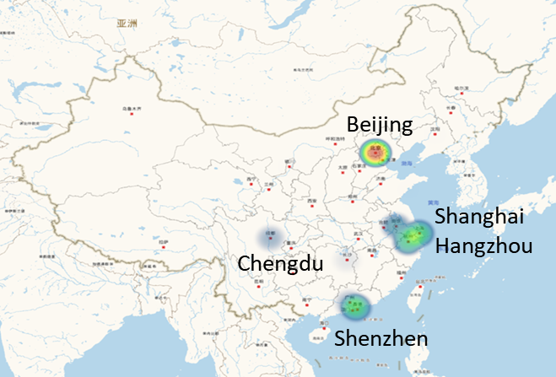







Angel outside Tencent
Weibio
Zhuanzhuan
Xiaomi
Huawei
Baidu
Pinduoduo
Netease
DiDi
China Telecom
Notes:
Angel outside Tencent
To statistic users out side of Tencent is a challenge. We have run a social media account, so that we can response user’s questions at the first time. All the statistics data is based on that account.
There are more than 100 companies and institutions use Angel in their products or inner system
Most of the users come form China. Especially from Beijing, shanghai, Hangzhou, Chengdu and Shenzhen
That left figure list the top companies that use Angel. As you see, Weibio, Xiaomi and HUAWEI are all our users.

Slide 7

Open source & Papers
7 Sub Projects
math2/format/mlcore
Angel
Serving
SONA (Spark ON Angel)
PyTorch On Angel
250K+ lines of java code
50K+ lines of scala code
370+ Issues:
Open: 84
Closed: 290
360+ Pull Requests
Open: 8
Closed: 340
2000+ Commits
8 Committers
34 Contributors
Key Stats
Stars, Fork and Watch
1000+ new stars since join LFAI
https://github.com/Angel-ML
Published Papers：
PS2: Parameter Server on Spark，Zhipeng Zhang, Bin Cui, Yingxia Shao, Lele Yu, Jiawei Jiang, Xupeng Miao， SIGMOD 2019
An Experimental Evaluation of Large Scale GBDT Systems，Fangcheng Fu, Jiawei Jiang, Yingxia Shao, Bin Cui， VLDB 2019
MLlib*: Fast Training of GLMs Using Spark Mllib，Zhipeng Zhang, Jiawei Jiang, Wentao Wu, Ce Zhang, Lele Yu, Bin Cui，ICDE 2019
Notes:
Open source statistics and papers
There are more than 4200 stars, more than 1000 forks, 7 sub projects, more than 300k lines of code
more than 2000 commits, 38 contributors, and 8 of them are committers
From those data, we can conclude that angel community is very active
What’s more, we have published three papers on top conference, such as SIGMOD, VLDB and ICDE.

Slide 8
Angel 3.0 features
Full Stack of ML
Training
Improved Computation Graph
Feature engineering
Serving
AutoML
PS Ecosystem
Spark On Angel
PS enhancement
PyTorch On Angel
Cloud
Yarn
Kubernetes
Feature engineering
Model training
Full Stack ML Pipeline
Angel
PS
Auto FE
Computing Graph
Spark On Angel
PyTorch On Angel
Mode serving
Tuning & evaluation
Trillion dimension model
YARN -> K8s
PS Ecosystem
Serving
AutoML
Notes:
This is an overview of the new features of Angel 3.0
The while, brown and red color are represent existing, enhanced and new arrival component.
- The new component including auto feature engineering, serving, PyTorch on Angel, AutoML and Kubernetes support
- The enhanced components including improved computation graph, spark on angel and PS
So, Angel 3.0 is a milestone version

Slide 9
Auto Feature Engineering (1/2)
Feature engineering is common in real applications
feature selection
feature cross
Spark on Angel enhances feature selection operators in Spark
Statistic-based: VarianceSelector, FtestSelector
Model-based: LassoSelector, RandomForestSelector
Automatic feature synthesis
Cross feature (cartesian product) of arbitrary features
Iterate this process to get high-order cross features
Challenge
Dimension curse: dimension easily exceeds the range of Int; Spark Vector only supports Int index
S1: implement long vector in Spark
S2: use feature selection to drop less important features
Notes:
Feature engineering is important in real world applications. For example, the online recommendation systems usually choose logistics regression model, because of its high throughput and low latency. However, the logistics regression model requires complex feature engineering to achieve high accuracy. After a comprehensive survey, we found that the feature selection and cross are more important.
Although Spark provide excellent feature engineering operators, it lacks of feature selection operators. We enhances feature selection operators in SONA by adding two categories of operators. One is statistic-based operators, including VarianceSelector, FtestSelector. The other is model-based operators, including LassoSelector, RandomForestSelector.
Automatic feature synthesis is challenge. Because the dimension easily exceeds the range of Integer type in computer and what’s more it easy to cause dimension curse.
For the first problem, we implement long index vector instead of integer index. For the second problem, We propose a iterative approach to generate high-order features. We call this iterative approach “auto feature engineering”. The proposed approach include to stage:
The amplification stage: Cartesian product of arbitrary features
Reduction stage: feature selection and feature re-index.

Slide 10
Auto Feature Engineering (2/2)
fields 1
fields 2
fields 3
Iterative feature synthesis
Feature cross
cartesian product of arbitrary input fields
Feature selection
set less important feature to zero
Re-index
selection does not decrease the maximal dimension
drop sparse columns
Concatenate: add to original features
Dimension increase linearly
Experiments: Higgs dataset
1 | 0 | 1
0 | 1
1 | 1
cross
0 | 0 | 1 | 1 | 0 | 0 | 0 | 0 | 0 | 0 | 1 | 1
select
0 | 0 | 0 | 1 | 0 | 0 | 0 | 0 | 0 | 0 | 1 | 0
re-index
1 | 1
 | LR | FM | Ours
AUC | 0.68 | 0.69 | 0.70
concatenate
1 | 0 | 1 | 0 | 1 | 1 | 1 | 1 | 1
Notes:
Here is an example of “auto feature engineering”
First, amplify feature through Cartesian product. The number of features increase fast
Next , select the most important features from last step. We have implemented several feature selection operators.
Then, re-index the selected feature to reduce the feature space
Last, append the new generated features to the existing features and finish an iteration
From the above procedure, we can easily to conclude that the dimension increase linearly.
The experiment on Higgs dataset, our approach superior to other methods in accuracy.

Slide 11
Spark On Angel (SONA, 1/3)
Integrate with Apache Spark
feature engineering is Integrated, not just copy operators form Spark, but add long index vector support for training sparse models.
seamlessly connected with automatic hyper parameter tuning
Spark fashion APIs, user friendly
Angel
job
Master
PS
PS
start/stop PS
create/load/save
Pull/Push
Spark
job
PSclient
PSclient
Angel Client
Task
Task
Task
Task
Task
Task
Driver
Executor
Executor
Notes:
Spark on Angel is short for SONA, not a new component. SONA is a stand alone machine learning library on Spark, just like Spark mllib. SONA do not depend on Spark mllib.
The previous SONA is based on RDD APIs, and only focus on model training. In Angel 3.0, we bring many new features :
First, feature engineering is Integrated. We are not just copy Spark’s feature engineering operators, we add long index vector to all the operators. As a result, SONA can train large sparse models.
Second, seamlessly connected with automatic hyper parameter tuning
Third, Spark-fashion APIs. There is no cost for spark users switch to Angel
What’s more, two new data format, LibFFM and Dummy are introduced
As show in this figure, the architecture of SONA remains unchanged. Since this architecture has released previously, I do not want to show the details again.

Slide 12
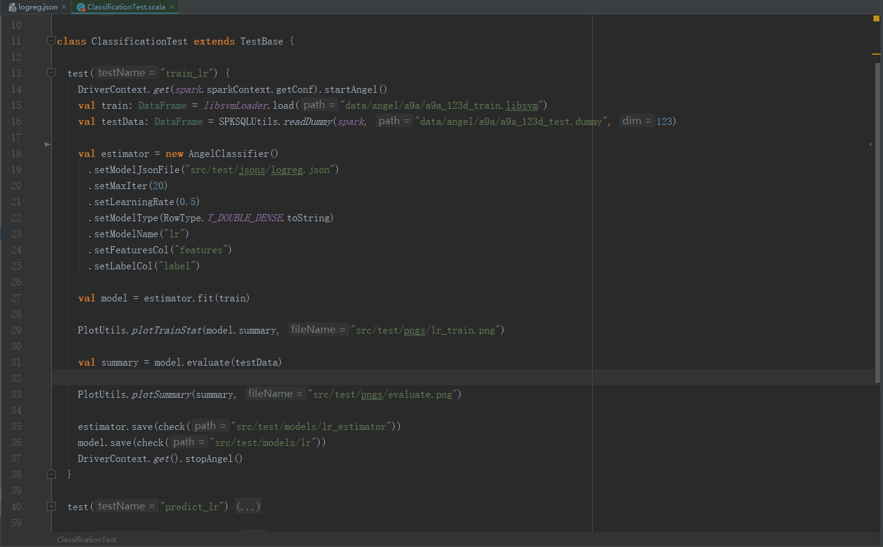
Spark On Angel (1/3)
Integrate with Apache Spark DataFrame APIs
Extends Spark’s Vector Type to support Long index vector
All the feature engineering Estimator/Transformer are adapted to Long index vector
Two data format, LibFFM and Dummy are introduced
Spark fashion APIs
Notes:
Here is a example of how to program in SONA
Start parameter server at the beginning and stop it in the end
Load the training and test data, both the training and test data are DataFrame
Define a Angel classifier and setting parameters in Spark-fashion. The algorithm is define in Json
Use “fit” to train model
Use “evaluate” to evaluate the trained model
After training, SONA will print many measure, such as accuracy, ROC curve, AUC score and so on.
At last, save the trained model

Slide 13
Spark On Angel (SONA, 2/3)
Spark and Angel are complementary at algorithms
Angel: Recom, GE/GNN (big models & sparse data)
Spark: general purpose
Spark
Angel
RF
DeepFM
PNN
PrefixSpan
GMM
GBDT
LINE
Bisecting k-means
LinearReg
DCN
Deep&Wide
SoftMax
SVM
Naive Bayes
LogReg
RobustReg
IsotonicReg
Word2Vec
DNN
AFM
SurvivalReg
Kmeans
KCore
MixedLR
FP-Growth
LDA
NFM
FM
Louvain
DecisionTree
Classification & Regression
Clustering
FPM
Others
Notes:
We also bring new algorithms, such as deep cross network, attention Factorization Machine. but in this slice, we want to highlight that the algorithms in SONA is different for those in Spark.
The algorithms in SONA mainly focus on recommendation and graph neural network, while algorithms in spark are general purpose.
Both the left figure and the right bar chart show the union of SONA and Spark is relative small

Slide 14
Spark On Angel (SONA, 3/3)
The algorithms on Angel are high performance
Epoch Running Time / min
Notes:
As for performance, we choose two popular algorithms, deep & wide and DeepFM, to compare with TensorFlow.
SONA run 3x time first the TensorFlow in deep & wide algorithms, while TensorFlow run a litter faster the SONA in DeepFM.
All the experiment are taken in the same condition on criteo dataset.
The results show SONA is efficient.

Slide 15
PyTorch On Angel (PyTONA, 1/2)
Tencent has one of the largest social networks in the world.
QQ: 1 billion nodes, 200 billion edges
WeChat Pay: 1 billion nodes, 10 billion edges
There are a variety of business scenarios on social networks
Credit Rating / Anti-fraud / Anti-money laundering
Item Recommendation
Graph learning on huge network is a challenge
Sparse Data / huge model / auto gradient
Angel
System | TensorFlow | PyTorch | Angel
Sparse Data & Huge models | x | x | √
Auto gradient | √ | √ | √
PyTorch
Notes:
PyTorch On Angel is short for PyTONA, a new component of Angel. PyTONA is origin form the inner requirement of Tencnet.
First of all, Tencent has one of the largest social networks in the world
QQ: 1 billion nodes, 200 billion edges
WeChat Pay: 1 billion nodes, 10 billion edges
Meanwhile, there are a variety of business scenarios on those social networks
Credit Rating / Anti-fraud / Anti-money laundering
Item Recommendation
To support those business scenarios is of great challenge, because the graph data is sparse and the model is huge
We survey some of the existing platform :
TensorFlow and PyTorch are excellent as auto gradient, but they are weak at dealing with sparse data and huge models
Angel is good at dealing with sparse data and huge model, but the computation graph in Angel is relative weak
As a result, we combine the advantage of Angel and PyTorch, and start a new project “PyTorch on Angel”

Slide 16
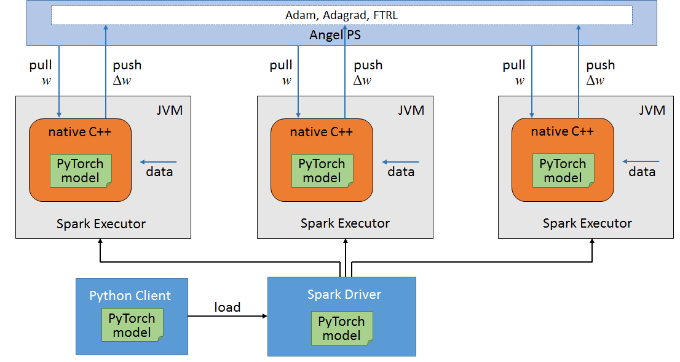
PyTorch On Angel (PyTONA, 2/2)
The Architecture of torch on Angel
Define your model in Python (torch script) and save the model in *.pt file
Train the model in distributed system:
PS: start Angel PS to store and update params
Driver: create, init, update and save the parameter
Worker: pull params from PS and feed to torch through JNI, torch load the *.pt model to do the training, fetch the gradient from torch and push to PS
2
1
Notes:
This is the architecture of PyTONA :
1) Define your model in Python (torch script) and save the model in *.pt file
2) Train the model in distributed system:
PS: to store and update parameters
Driver: create, initial, update and save the parameter
Worker: pull parameter from PS and feed to torch through JNI, torch load the *.pt model to do the training, fetch the gradient from torch and push to PS
The distributed part is transparent to end users, user the only have to care the Python part

Slide 17
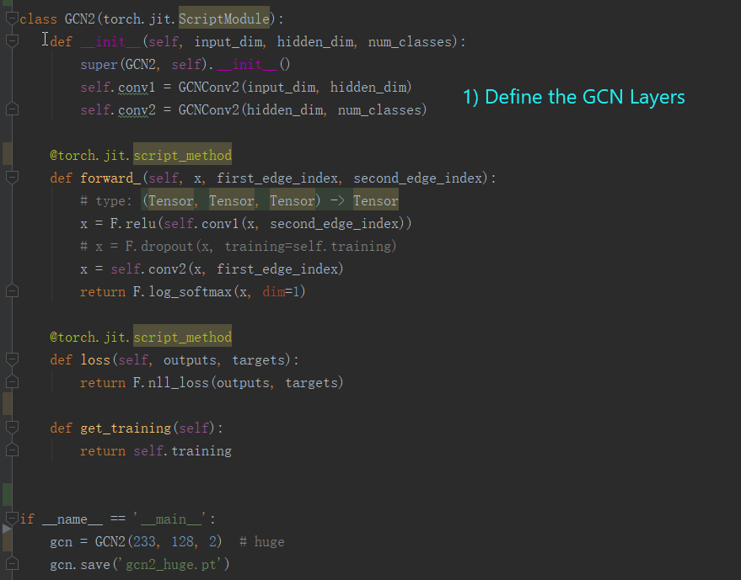
Algorithms on torch
Graph neural network
GCN
GraphSAGE
Recommendation
FM
DeepFM
xDeepFM
DCN
Deep & Wide
PNN
Notes:
We have implement many algorithms, such as GCN and GraphSAGE. Taken GCN as an example:
First, Define the two GCN layers in the init function
Second, define the forward process
Next, create a loss function
Last, create a *.pt file for c++
After generate the *.pt file, you can submit it to PyTorch on Angel

Slide 18
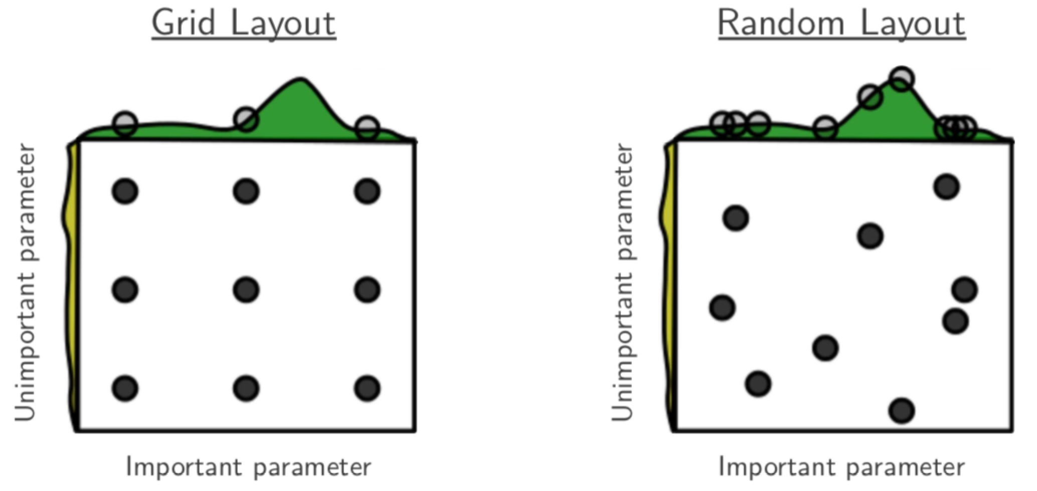
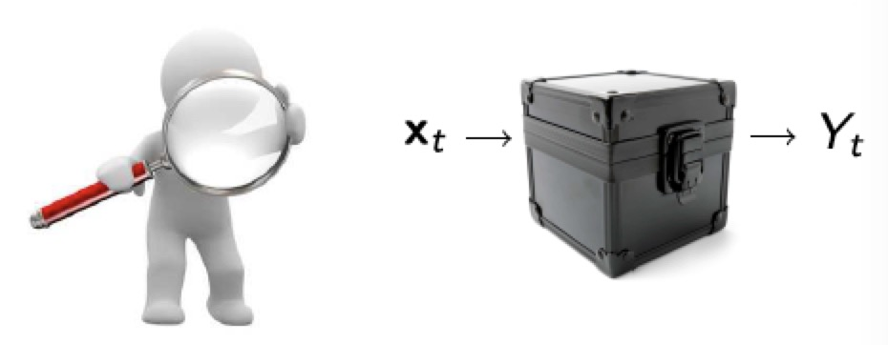



Hyper Parameter Tuning(1/2)
Manual hyperparameter tuning in ML is exhausted.
Modeless approaches
Grid search
Divide the search space by grids
Assume hyperparameters are equally important
Random Search
Only a few hyperparameters matter
Require many expensive evaluations
Probably cannot find the optimality
Bayesian optimization
Black-box problem
Input: hyperparameter
Output: metrics of model quality
Use model to approximate this black-box problem
Suggest-evaluate-feedback loop
Can find better result
?
$$x$$
$$f\left(x\right)+∈$$
$$x^{∗}=argmax f(x)$$
Notes:
Manual hyper parameter tuning in ML is exhausted. There are several traditional hyper parameter tuning approaches
Grid search: this method divides the search space by grids; assumes the distribution of hyper parameters are uniform. However, on one hand, the computation increase exponentially with respect to number of parameters; on the other hand, the distribution of the hyper parameter is usually not uniform, so grid search may miss the optima in high probability.
Random Search: this method sample a sequence of hyper parameters randomly from the configuration space, and evaluate the sampled hyper parameters to select a better combination. However, the random search strategy is inefficiency.
Bayesian optimization: Bayesian optimization use a cheap surrogate function to approximate the expensive target function. The surrogate function can generate mean and variance for a given hyper parameter combination, and an acquisition functions evaluate the generated combinations to get a score. The larger the score is , the better accuracy the combination will achieve on the target function.
Comparing to grid search and random search, Bayesian optimization require less evaluation on the expensive target function.

Slide 19
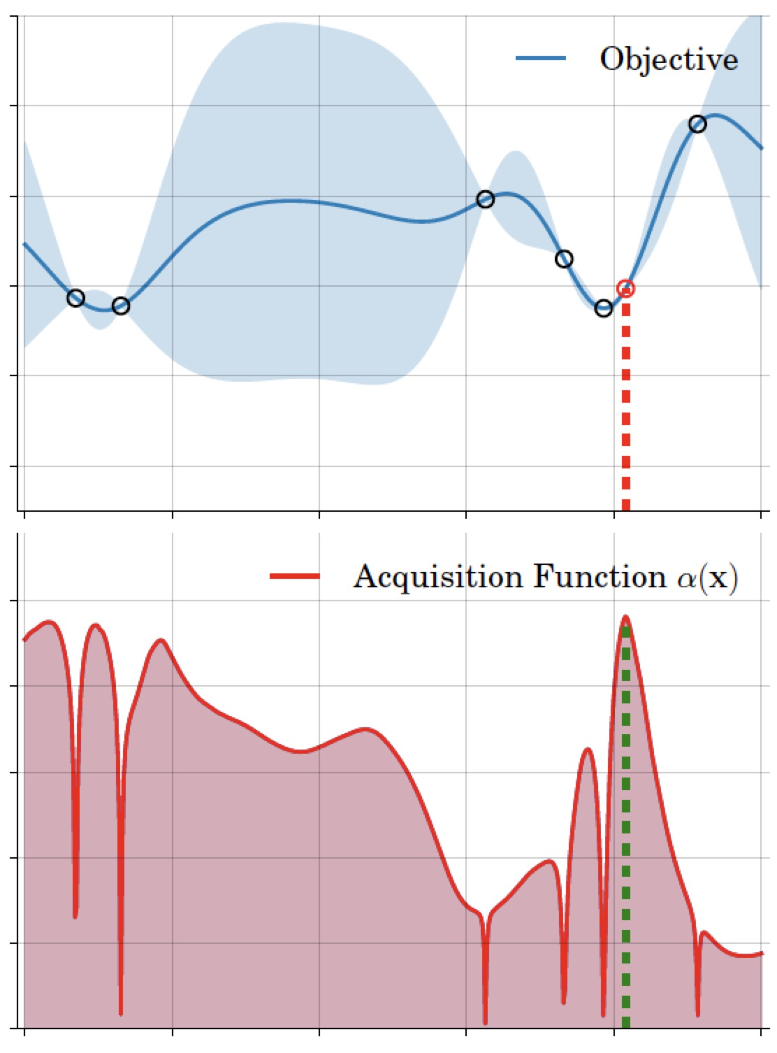
Hyper Parameter Tuning(2/2)
Grid search and random search
Bayesian optimization
Surrogate: probabilistic model for the black-box function
Gaussian process (GP), random forest
Covariance functions for GP
EM+LBFGS to optimize covariance functions
Acquisition function: metric to decide the next input
EI/PI/GP-UCB
Early stopping
Experiments on logistic regression
 | Random | Grid | GP
AUC | 0.926 | 0.924 | 0.933
Notes:
In the new release, we have implement all the mentioned grid search, random search and Bayesian optimization.
Here we want to highlight Bayesian optimization.
there are two surrogates, Gaussian process and random forest. We use EM+LBFGS to optimize the hyper parameter in kernel function of Gaussian process.
we have implemented several popular acquisition function, such as EI/PI/UCB (probability of improvement, Expected Improvement and Upper Confidence Bound)
As you know, evaluating the target function is expensive. If we found a hyper parameter combination is worse in the first several iteration, we can stop the following evaluation. This technology called early stopping. We also implement the early stopping strategy.
Our experiment on logistics regression show that Bayesian optimization is better than random search, and random search is better than grid search. This result is consistent with our expectation.

Slide 20
Angel Serving
Architecture
Access through gRPC and Restful API
Cross Platform
Angel
Torch
PMML: Spark, XGBoost
Fine grain version control :
Earliest
Latest
Specified
Fine grain service monitoring
QPS: Query per second
Number of exception requests
Response time distribution
Average response Time
CPU/Mem/GPU/Network usage
gRPC Server
Aspired Version Manager
Server Core
HTTP Server
Source
Loader
Angel Servable
PMML Servable
Pluggable Servable
Spark Servable
PyTorch Servable
Notes:
As more and more deep learning algorithms are implemented on Angel, efficient model service becomes urgent. In Angel 3.0, we add the model serving to the machine learning pipeline, and making it a closed loop.
The left figure show the architecture of Angel serving.
users can access Angel serving through gRPC and Restful API.
Angel serving is a general machine learning serving framework. There is a pluggable mechanism for the third part platform join in. Angel serving Now we support:
Angel
Torch
PMML format: through the PMML format, we can server models from Spark and XGBoost
Similar to TensorFlow serving, we provide fine grain version control :
Earliest
Latest
Specified
Apart from version control, angel serving also provide fine grain service monitoring, including
QPS: Query per second
Number of exception requests
Response time distribution
Average response Time
CPU/Mem/GPU/Network usage

Slide 21
Angel-Serving vs TF-Serving
Platform | Angel-Serving | TF-Serving
Angel | √ | x
Spark | √ | x
PyTorch | √ | x
PMML | √ | x
TensorFlow | x | √
 | Angel-Serving | TF-Serving
Total time(s) | 56 | 59
Min(ms) | 1 | 1
Avg(ms) | 2 | 2
99% consume(ms) | 2 | 3
QPS | 1900 | 1800
Total requests: 100000
Test environment: 24cores 24G
Concurrent thread: 5
Model: DeepFM (100w features)
Notes:
We compare Angel serving with TF serving.
The left table show that Angel serving can cross platform, while TF Serving is design for TensorFlow models.
The right table is a performance comparison with TensorFlow in multiple dimension.
The test model is DeepFM with 1 million features. Total 100 thousand requests.
The total time of Angel serving and TF serving are 56 and 59 seconds respectively
The average response time is 2 milliseconds for both Angel serving and TF serving
The QPS of Angel serving is 19 hundred , while TF serving is 18 hundred
All the result shows Angel serving is comparable with TF serving (actually a litter better).

Slide 22
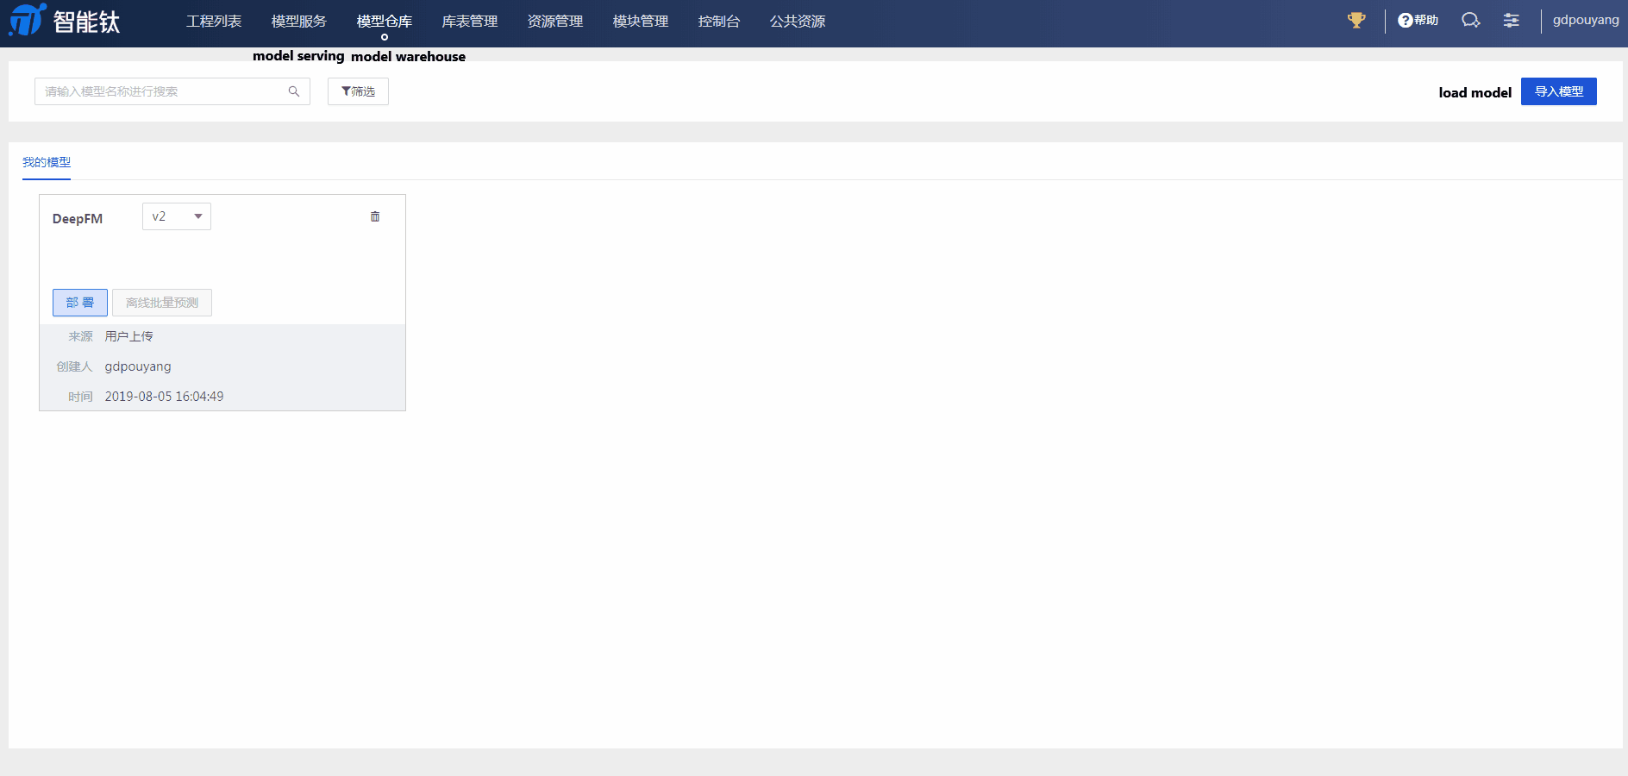
Notes:
Angel serving has integrated with TI one. TI one is a machine platform on Tencent cloud. Let take a look.
First, load a model form local or HDFS
Then, choose a version and deploy
The backend will create and load the serving image, so it will take a while
After the serving is ready, you can test it
OK, that ‘s all the new features of Angel 3.0. let’s shared two user cases.

Slide 23



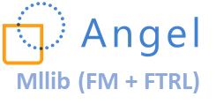
Short Video Recommendation in Tencent
Kafka
Storm
Real-time
Feature
Generator
15min
Model
Falcon-X (XFAL)
Online Learning
user/video play
context
query
features
reset
Baseline Model
CKV (Tencent)
Berkeley DB
user profile
video profile
HDFS
1 day
Feature size: 63+ k
Data Volume: 2.4 billion samples (450G)
Previous training time: 10+ hours
Angel training time: 1 hour (batchSize=200, 20 min per epoch), 10 times promote
Note: the baseline model also used in prediction phase to monitor the performance of online model, in case of it getting worse
Notes:
The first user case is form Tencent short video department.
The user's video play log and context information are forward to kafka in real time, and the stream computation engine, Storm, subscribes to the data from kafka. In Storm, there is a real-time feature generator that queries user and video profiles from the KV store to generate features. The generated features are forward to the online training system to update the online model on the one hand. On the other hand, those features are dumped into HDFS for offline training. The offline model is used to initialize the online system and reset the online system when there is an exception. The algorithm used is FM, with a data dimension of 63+K, 2.4 billion samples.
Before the provious the training duration is 10+ hours (based on spark), and after using Angel, it is down to 1 hour.

Slide 24




Financial Anti-Fraud in Tencent
Angel
Fraud risk model
Anti-Fraud strategy
louvain
Heterogeneous network
- Payment / Transaction
- Mobile (shared devices)
- Wi-Fi (colocation)
Communities
User profile
Network Feats
Data Volume: 1.5 billion nodes, 20billion edges (275G)
Previous running time: 20+ hours (based on GraphX)
Angel running time: 5 hours (batchSize=200, avg 30 min per epoch)
4 times promote
Notes:
Another user case is Financial Anti-Fraud in Tencent.
The network is heterogeneous, there are several types of edge:
Payment edge: if user A pay money to use B, there is an edge between A and B
Device edge : if user A and user B shared the same device, there is a edge between them.
Wi-Fi edge: if two user access the Internet through the same Wi-Fi, then there is an edge between them
The underlying reason is the financial fraud gang usually share Wi-Fi and device.
The fast unfolding algorithm in Angel is used to discover communities. Fraud risk model use the discovered communities, user and network features as input to create a anti-fraud strategy.
Let focus on the fast unfolding step. The graph including 1 and a half billion nodes, 20 billion edges. The previous implementation is based on spark GraphX. It takes about 20 hours to finish the training. While Angel only takes 5 hours.

Slide 25


Thank You!
Angel GitHub
Angel @ LFAI
Notes:
Thank you for you attention !
If you interest in our project, you can scan the QR code for more information!

